Slide 1

GOAL SETTING Meeting - 2025

Slide 2
Objective of Goal Setting Meeting
Goal Alignment:
Vice Chairman
Create transparency and alignment behind Divisional/Functional strategic priorities.
Enable employees to see a direct link between individual goals and Division/ Functional strategic objectives.
Reinforce what high performance looks like for the team.
Clarify what great will look like and what metrics will be followed.
Help employees focus on team goals, coordinate work with peers & understand interdependencies to achieve goals.
Help employees create SMART Goals and put goals on People Hub.
Division/Function Leadership
Department heads
People Managers
Individual Contributors

Slide 3
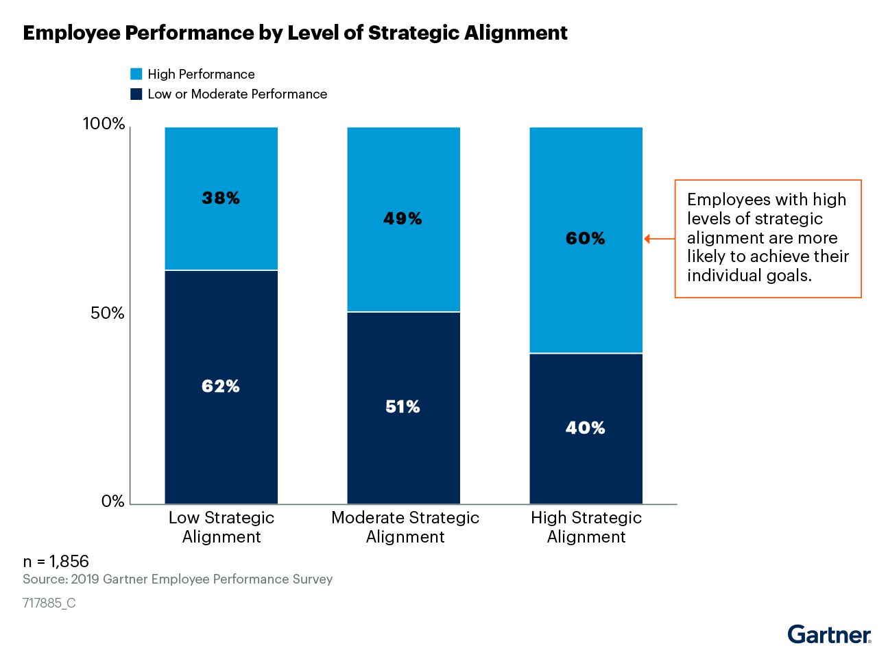
Purpose of Goal Setting
Provides a clear line of sight, connecting individual contribution to overall business results. Clarifies the expectations
As an individual
Or as part of a team
Ensures that individual goals are aligned, and that cumulatively they deliver on the expectations of the team, unit and division.

Slide 4
Divisional/Functional Strategic Priorities
Divisional/Functional Strategic Priorities

Slide 5
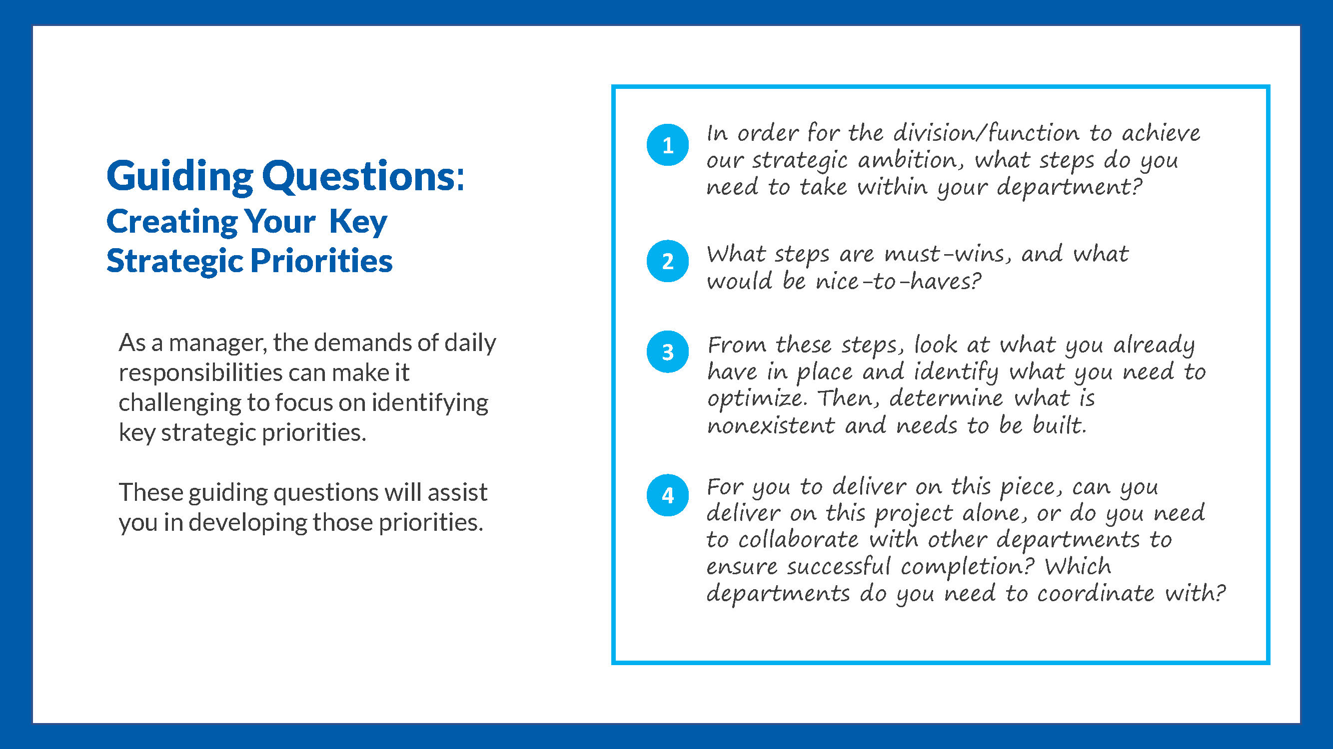

Slide 6
2025 Priorities & Opportunities
Priorities & Opportunities Sheet
Individual Priorities
Priority 1 | 1. ………………………………….... 2. …………………………………....
Priority 2 | 1. ………………………………….... 2. …………………………………....
Priority 3 | 1. ………………………………….... 2. …………………………………....
Priorities that need to be owned by the full team | Opportunities to collaborate with different peers.
1. ………………………………….... 2. ………………………………….... | 1. ………………………………….... 2. …………………………………....

Slide 7
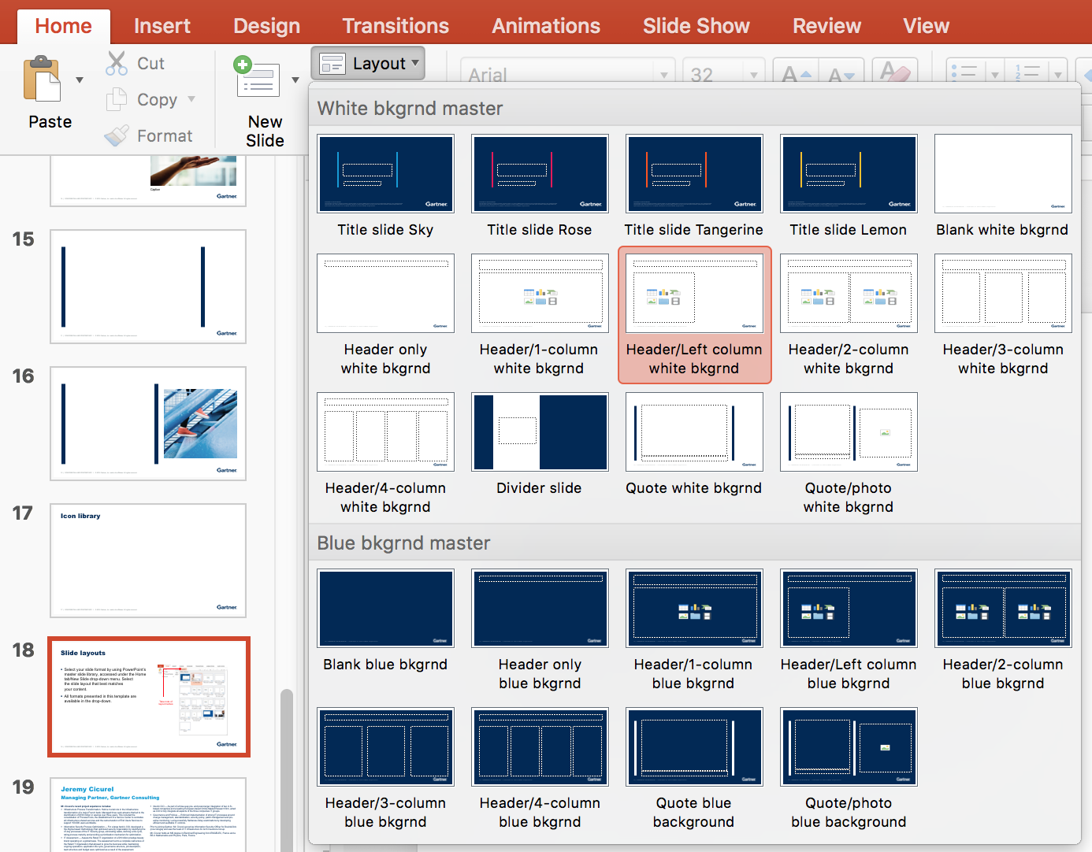
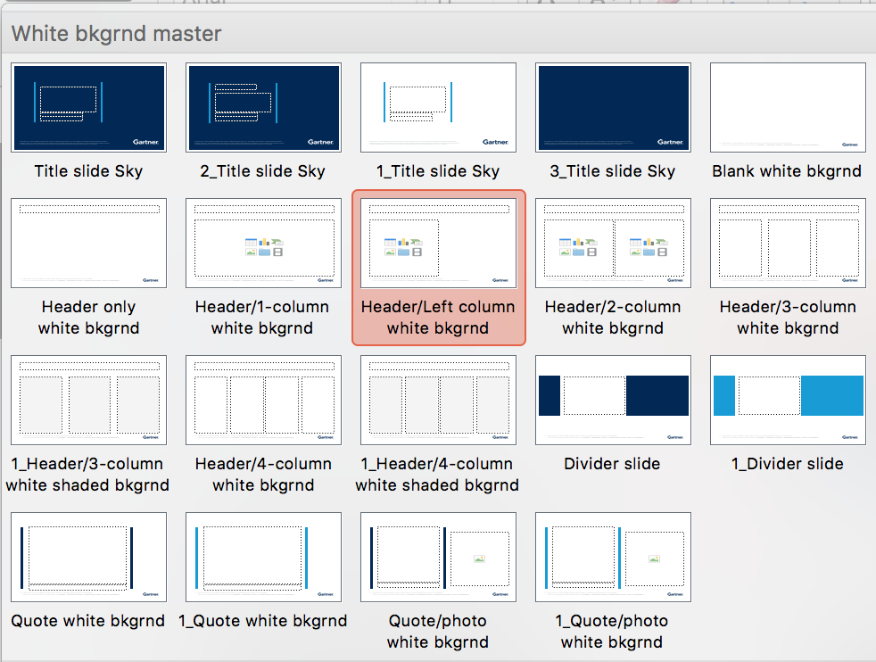
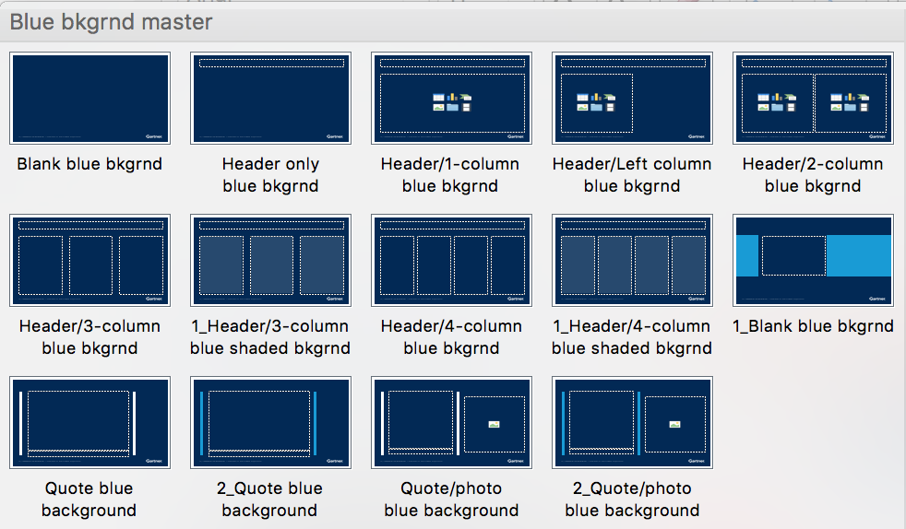
Time To Set Your Individual Goals Setting
Instructions: Activity 3: (15 min): Requesting attendees to think of top 2 goals they need to develop ensuring they added KPI for each goals.
Individual SMART Goals | Success Measures
#Goal 1:
#Goal 2:
Before you develop your goals:
Ensure goals are aligned to divisional/functional goals.
Ensure all interdependencies have been identified .
Validate that measures selected are an indication of success in your goal.
Check that your individual goals are adding up to the team ambition

Slide 8




Peer Goal Sharing
Demonstrate how peers can challenge goals
Employee goal refinement
Collective teasing of goals
Collaboration mapping
Employee to share with peer their two goals & peer start using the questions in the next slide to challenge the developed goals.
Employee refine goals based on peer feedback & switch roles & repeat activity
Employee starts mapping out who they need to collaborate with to achieve their individual goals
Team regroup. Volunteer start sharing individual goals with the entire team to collectively test with the HRBP & meeting owner and ensure successful output from activity. (preferable 4-5 volunteers)

Slide 9
Peer Goal Sharing-
Sample questions peers can use for providing feedback on individual goals
Are you working on the right goals to deliver your “piece of the puzzle” for our Division/Function goals?
Are these goals within your sphere of influence? If no, what are the interdependences?
Are your goals ambitious enough?
Have you identified what help you need from your team and peers to achieve your goals?
What are the risks to delivery of your goal? What steps will you take to mitigate the risk?

Slide 10
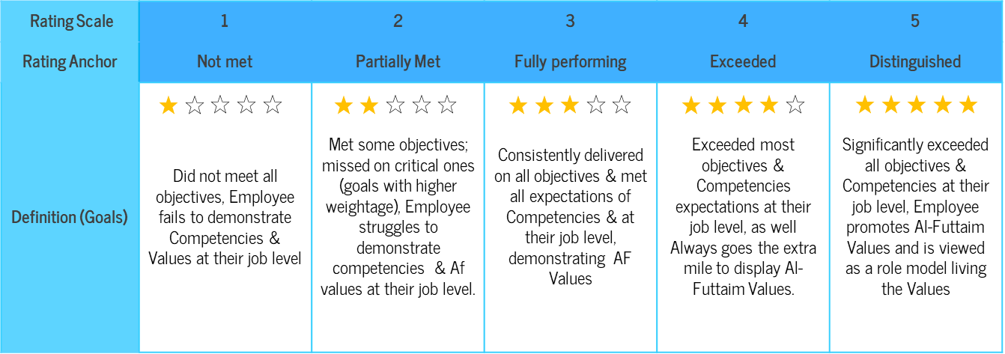
Identify Success Measures for Your Goals
Instructions: HRBP to explain to attendees what are the success measures they need to consider while setting goals. Ask the attendees to Reflect on the questions below to identify how measures of success can be added to your goals at fully performing, exceeded and distinguished levels.
What does high performance look like in delivering your individual goals?
How will the goals be measured? What will ‘Fully performing’ look like?
What will ‘exceeded’ and ‘distinguished’ look like?
Achieving a ‘meets’ level, in aggregate, should be equivalent to the business unit or function successfully delivering its stretch business goals.

Slide 11
Al-Futtaim Balanced Score Card (BSC)
Instructions: Meeting owner to explain how BSC translated into Divisional/Functional goals & how Al-Futtaim use this to measure the performance of its employees and provides clarity and transparency to those employees and businesses in order for them to develop in their own roles and contribute to the progress of the organisation.
It is recommended that the number of goals should be between 3-6 for each individual and that no goal holds less than 10% weighting. The weight of each goal should be indicative of the amount of effort and work required to deliver on that goal. The sum total of the goals should add up to 100%.
04. FINANCIAL
01. MARKET
KPIs of how well Al-Futtaim is performing financially, including revenue, profitability and expenses.
Al-Futtaim’s performance in the context of the external or internal market; this includes customers, suppliers and principals
AL-FUTTAIM VALUES
LEADERSHIP COMPETENCIES
03. BUSINESS EXCELLENCE
02. PEOPLE
The internal processes Al-Futtaim uses to get the work done. making sure we optimise performance efficiency & effectiveness. Can also include major projects
Al-Futtaim performance on people metrics engagement, succession planning, Emiratisation.
BSC enables measurement of business performance across four quadrants:
Notes:
This is how the BSC is built if you have a goal falls under this.

Slide 12
Setting SMART GOALS
Ensuring clarity around the objective set.
Ask yourself, “if someone outside of my team read this objective, would they understand what I aim to achieve”.
S
SPECIFIC
M
MEASURABLE
Defining the metric to assess success.
The more this is spelt out, the more objective one can be during the year end evaluation. The measure can be both quantitative or qualitative. Ideally it also defines the permissible margin of deviation.
A
Ensure the goals are challenging and provide a stretch beyond the regular everyday work.
Ensure that the right tools, capabilities and knowledge are in place to deliver on the objective.
ACHIEVABLE
R
RELEVANT
Does it tie into the strategic priorities of your business
T
Specify a date or amount of time when the goal must be completed
TIME-BOUND

Slide 13
AI Video

Slide 15
SYSTEM NAVIGATION

Slide 18

Thank you for your time!
Any questions?

